Slide 1
What is the risk of Netflix stock in 2017?
Visualizations created for the Netflix Stock Profile Team

Slide 2
The visualizations we’ll use to assess the risk:
The distribution of the stock prices for the past year
The actual vs. estimated earnings per share for the four quarters in 2017
Netflix's earnings and revenue in the last four quarters
A comparison of the Netflix Stock price vs the Dow Jones Industrial Average price in 2017
Note: We are using the Dow Jones Industrial Average to compare the Netflix stock to the larger stock market.

Slide 3
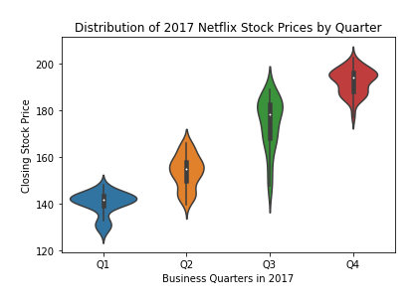
Which quarter did stocks fluctuate the most?
The stock price increased over the course of 2017.
There are a range of prices for each quarter. Q1 from 125 to 155; Q2, from 130 to 170; Q3 from 135 to 200; and Q4 from 175 to 210.
The highest price was 210 and lowest was 125.

Slide 4
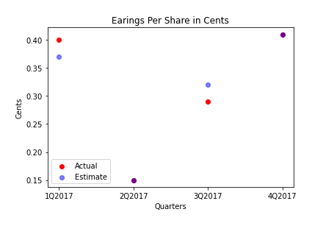
How did the Earnings Per Share perform?
In 2017, the actual earnings of the netflix stock and the estimated earnings per share by Yahoo!Finance were the same for Q2 and Q4.
The actual earnings were above the estimate in Q1 and below in Q3.

Slide 5
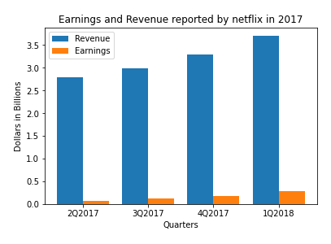
Earnings and Revenue
Revenue is the income a company generates before deducting expenses.
Earnings, on the other hand, represents the profit a company has earned; it is calculated by subtracting expenses, interest, and taxes from revenue.
The revenue increased over 2017, as did the earnings.
Revenue increased by $.91B, and earnings increased by $.22B.

Slide 6
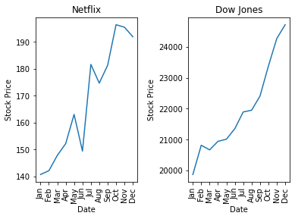
Netflix vs. Dow Jones
Netflix trended the same as Dow Jones, with some volatility, and a downturn at the end of the year.

